Slide 1
HOW ABIOTIC AND BIOTIC FACTORS INFLUENCE HUMAN POPULATIONS

Slide 2
Objectives:
To know the meaning of the terms “abiotic” and “biotic”.
Give examples of abiotic and biotic factors.
Outline the impacts biotic and abiotic factors have on the distribution and activities of human populations.

Slide 4
Abiotic factors are non-living conditions which can influence where plants or animals live.
Examples of abiotic factors include:
temperature
light intensity
moisture content of soil
pH of the environment

Slide 5
Abiotic Factors
Abiotic Factors can be categorized as:
Meteorological - (wind speed and direction, temperature, humidity, rainfall, solar radiation.)
Soil - (pH, soil aeration, nutrient availability.)
Water- ( pH , salinity, Biochemical oxygen demand(BOD)

Slide 6
Abiotic Factors

Slide 7
HISTORICALLY HOW ABIOTIC FACTORS HAVE INFLUENCED POPULATION SETTLEMENTS
Guyana
More than 90 percent of Guyana's population lived along the coast, on a strip constituting only 5 percent of the country's total land area.
More than 70 percent of Guyana's coastal population is rural, living on plantations or in villages strung along the coastal road.
The layout of the villages is dictated by the drainage and irrigation systems of the plantations, both active and abandoned.

Slide 8
HISTORICALLY HOW ABIOTIC FACTORS HAVE INFLUENCED POPULATION SETTLEMENTS
The pattern of population distribution in Guyana is a product of nineteenth-century economic development, which was based on the cultivation of sugarcane (see The Early British Colony and the Labor Problem , ch. 1). Because the swampy coast was fertile and sugar production was geared to export, the large sugar estates confined their operations to a narrow coastal strip.

Slide 9
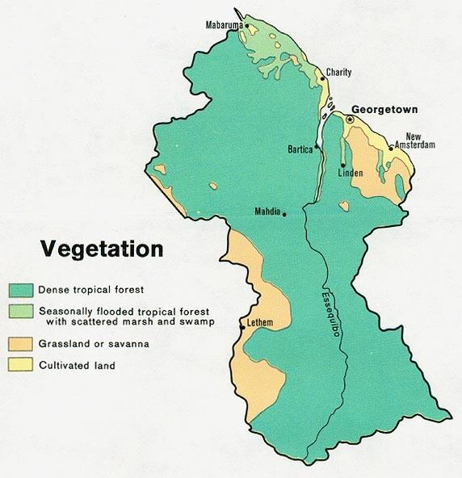

Slide 10
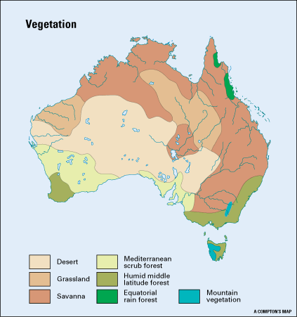
AUSTRALIAN POPULATION DENSITY MAP
AUSTRALIAN VEGETATION CATERGORIES MAP

Slide 11
BIOTIC FACTORS
In general, biotic factors are the living components of an ecosystem and are sorted into three groups: producers or autotrophs, consumers or heterotrophs, and decomposers or detritivores.

Slide 12
How do biotic factors affect human populations?
An environment limits population growth
by changing birth and
death rates.
The factors affecting population size and growth include biotic factors such as
Food availablity,
disease,
competitors, and
predators.

Slide 13
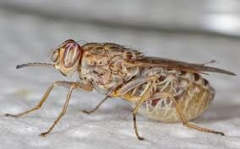
E.g.
The Tsetse fly is unique to the African continent and transmits a parasite harmful
The Tsetse fly reduced the ability of Africans to generate an agricultural surplus historically by limiting the use of domesticated animals and inhibiting the adoption of animal-powered technologies.

Slide 14
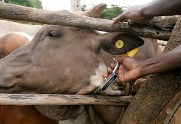
The tsetse fly is only found in Africa.
They feeds strictly on vertebrate blood and transmits Trypanosomiasis, a parasite causing sleeping sickness in humans and nagana in domesticated animals.
Livestock tend to be more affected than people since there are more types of trypanosomes that can infect them and they preferentially feeds on nonhuman animal hosts.

Slide 15
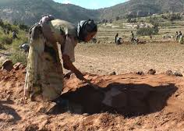
By affecting the use of domesticated animals as a source of draft power for transport the fly has hindered the ability of Africans to generate an agricultural (livestock and crop) surplus and easily transport goods overland.
This population pressure resulted in the movement away of pastoral societies from Sub-Saharan Africa.

